Slide 1
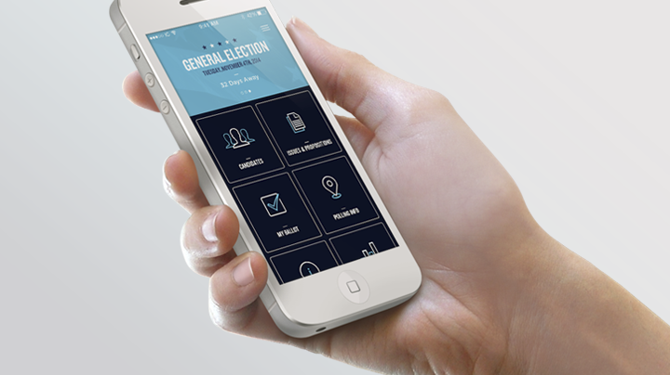
UI Design Analysis
Roberto Abarca M.

Slide 2

200 billion of native apps are expected to be downloaded in 2017.
On 2015, most companies spent about $3 billion on app advertising alone.

Slide 3

Simple work ?
As many as 25% of app users open an app once and never return.
Fields such as e-commerce, insurance, travel, food ordering, ticket sales, services and financial management.

Slide 4
What’s UI design ?
Is the design of user interfaces for machines and software.
Such as computers, home appliances, mobile devices, and other electronic devices, with the focus on maximizing usability and the user experience.

Slide 5
What are UI design patterns ?
A UI design pattern is a reusable solution to a commonly occurring problem you might encounter every day. It is a formalized best practice, a guide or template, that designers, developers, and product managers (and anyone else who touches product) can use to solve common problems when designing a mobile application or system.

Slide 6
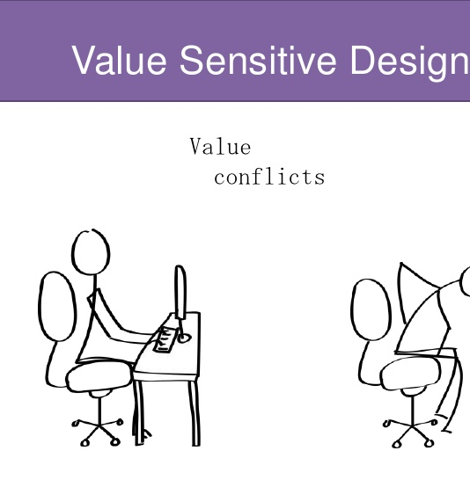
Value sensitive design.-
It’s an approach to create technology that takes into account human values or needs.

Slide 7
Values.-
Considering the impact of a technology on humans and designing a system accordingly.
Ex: Spotify
What does Spotify value as a company? Consumers or musicians?
It’s clear that spotify values more their customers and their values (what they are looking for) than the musicians

Slide 8
Stakeholders.-
People affected by the system.
Ex: Spotify
Indirect stakeholders: File sharing websites
Direct stakeholders: Music companies, Artists, customers.
Stakeholders allows us to analyze the people affected by this UI and how to check

Slide 9
Pervasiveness.-
How a system will spread and affect people on the long run.
Ex: Spotify
They penetrate their market by making music free and only paying for special content. It is related to the strategy of the company.

Slide 10
Time.-
How systems will function in short and long time.
Ex: Spotify
Short-run:
Keeping spotify free
Spreading the word
Long-run:
Incorporating new artists
More premium memberships
More advertisements
This helps us to analyze the short-run and long-run goals that we have for the app.

Slide 11
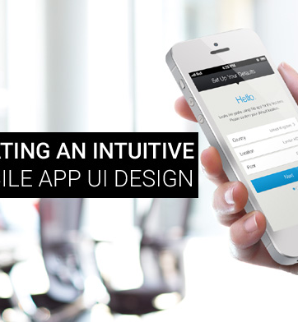
Why do we care ?
Because we design for humans. At the end of the day all our technical expertise must be directed to make an app not only “intuitive” but of use to for the owner of the app. Keep in mind that a user, doesn’t value the “app” but the benefit that it brings for him/her.

Slide 12
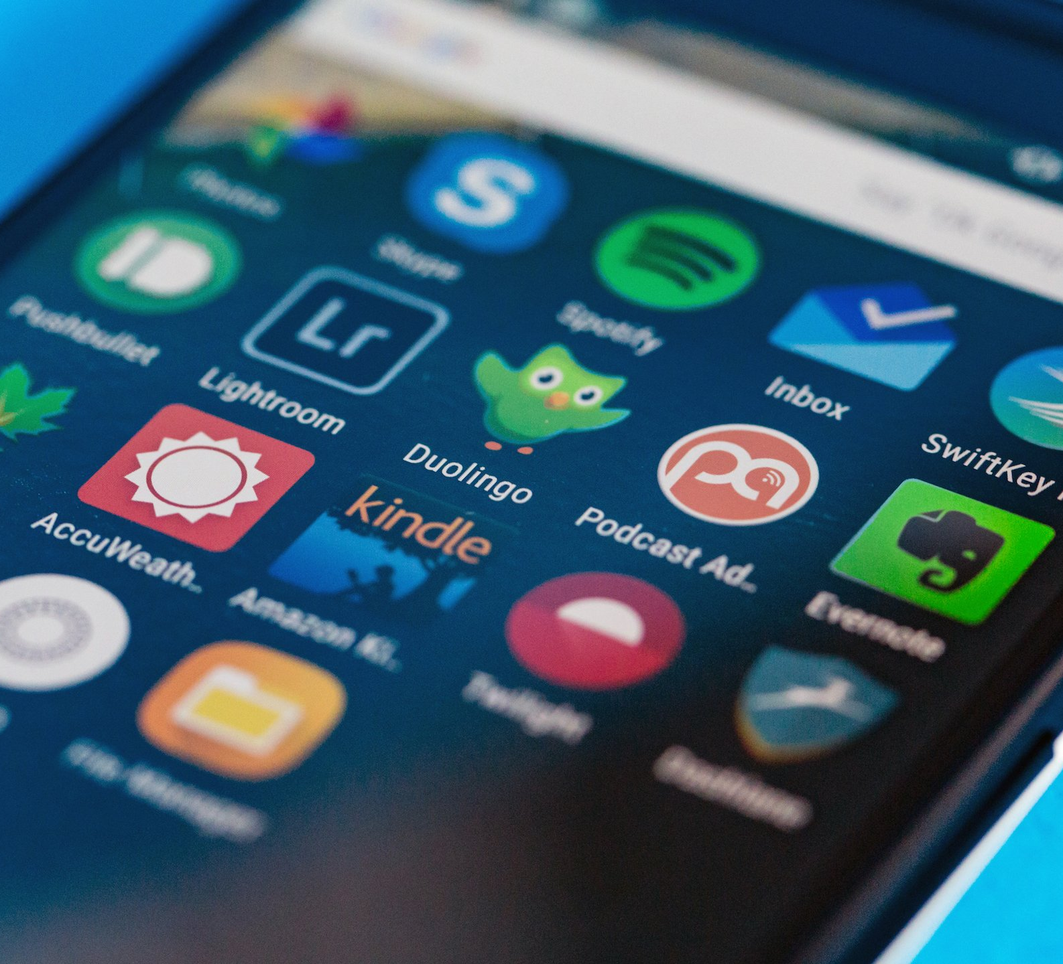
New Usability Principles for apps.-
There is about 25 usability principles for app development
You must understand the flow and each elements of the app.
This creates the experience for the users.

Slide 13
CHAPTERS
App navigation and exploration
In app search
Commerce and conversions
Registration
Form entry
Usability and comprehension

Slide 14
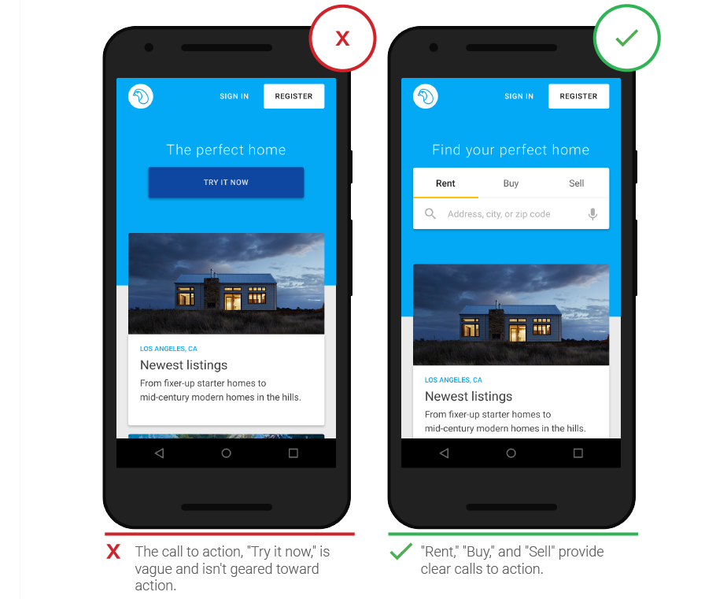
Chapter 1: App navigation and exploration

Slide 15
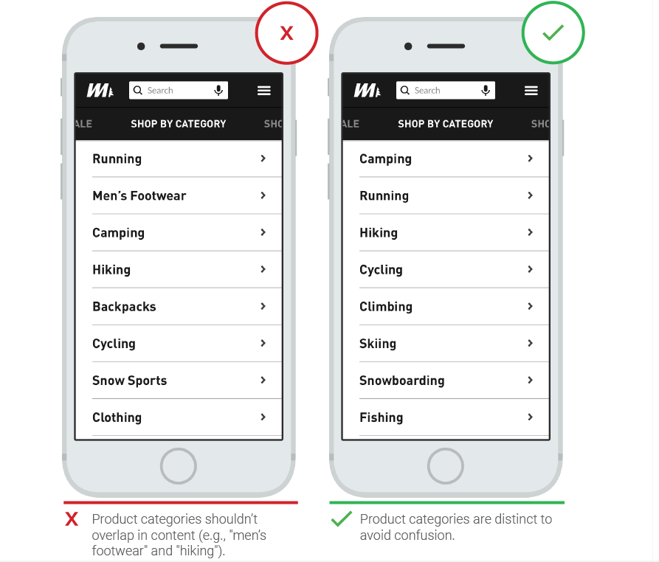
Organize and label menu categories to be user-friendly.

Slide 16
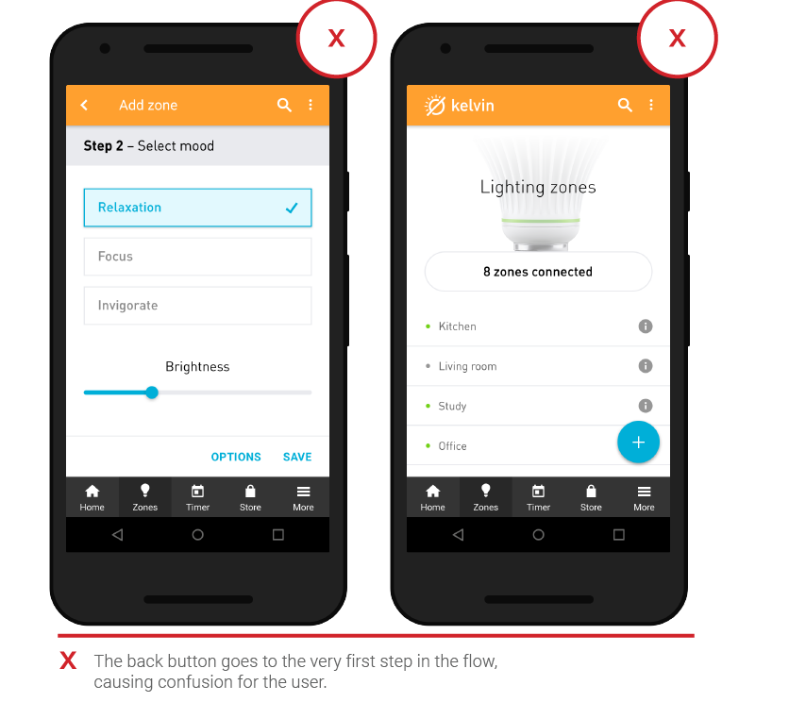
Allow users to "go back" easily in one step.

Slide 17
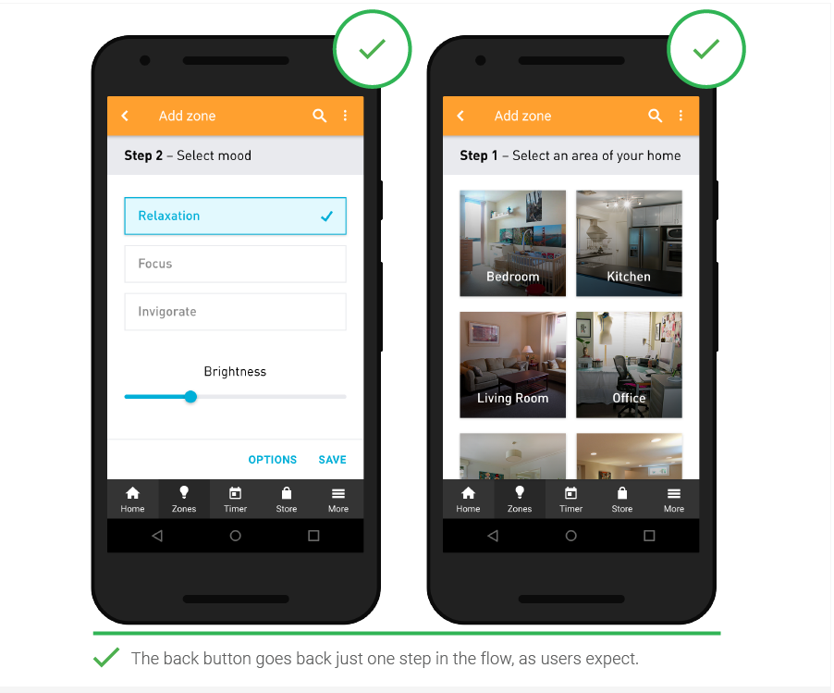

Slide 18
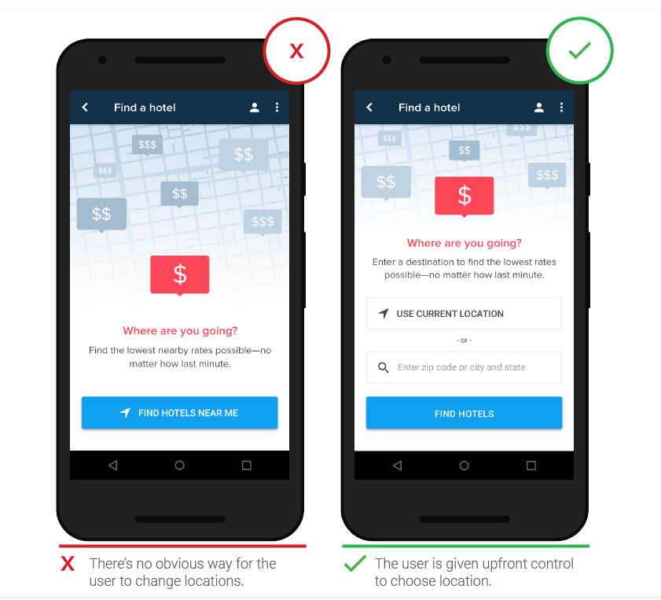
Make it easy to manually change location.

Slide 19
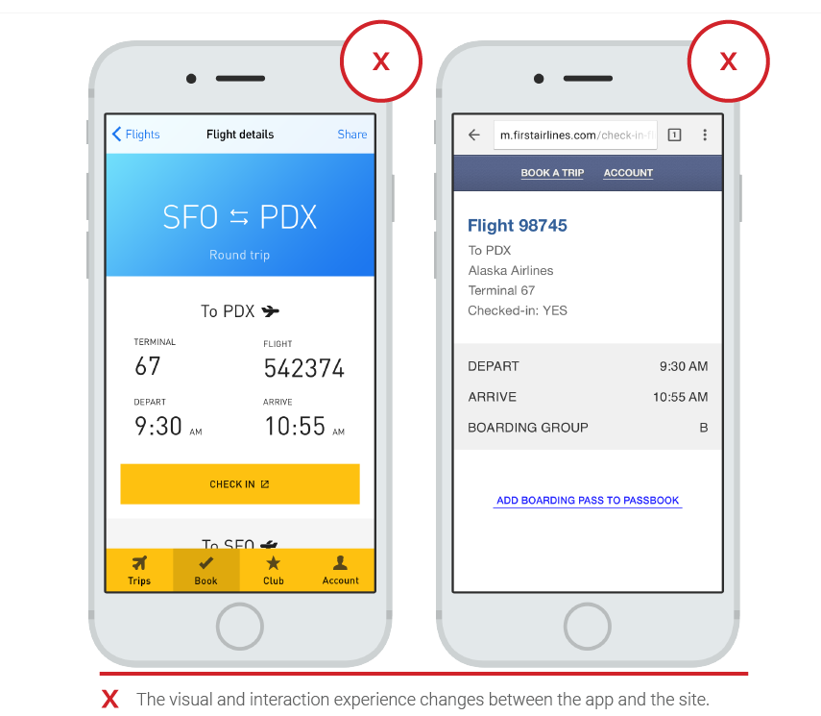
Create frictionless transitions between mobile apps and the mobile web

Slide 20
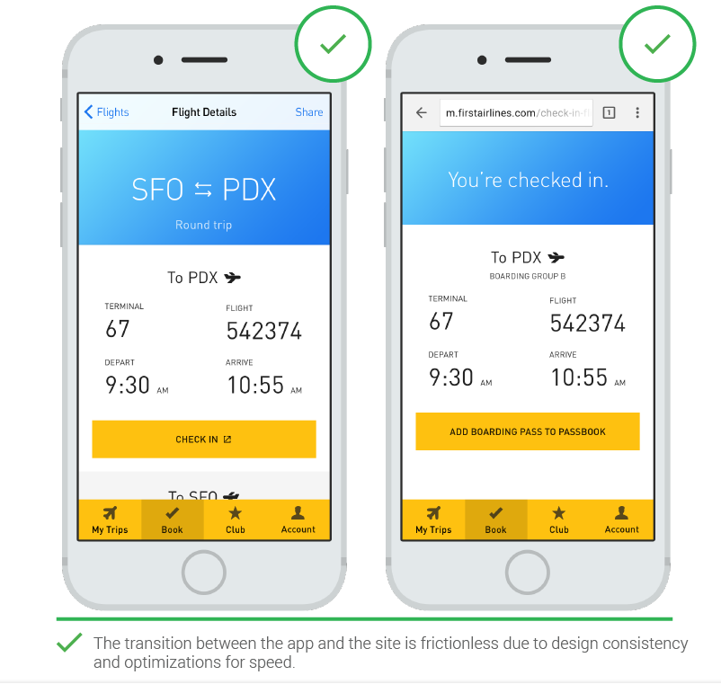

Slide 21
Chapter 2: In-App Search

Slide 22
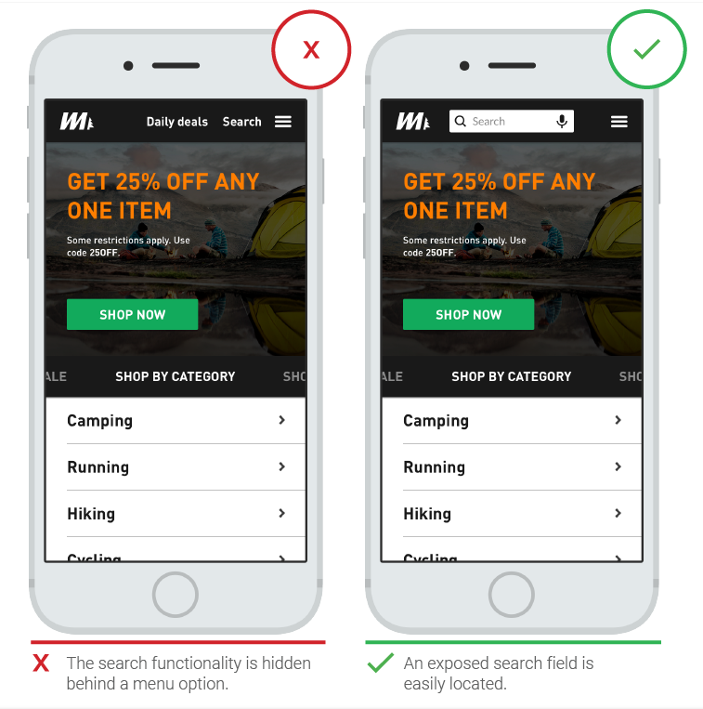
Prominently display the search field.

Slide 23
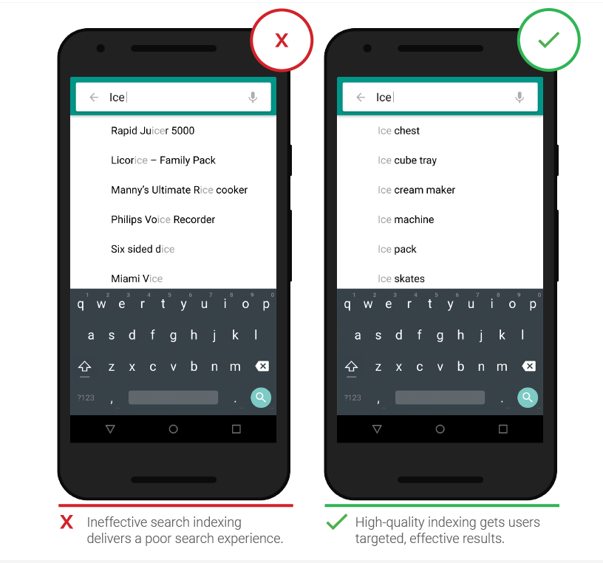
Use effective search indexing.

Slide 24
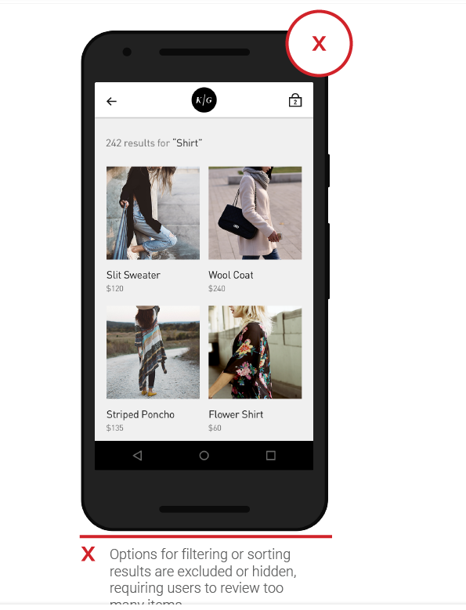
Provide filter and sort options.

Slide 25
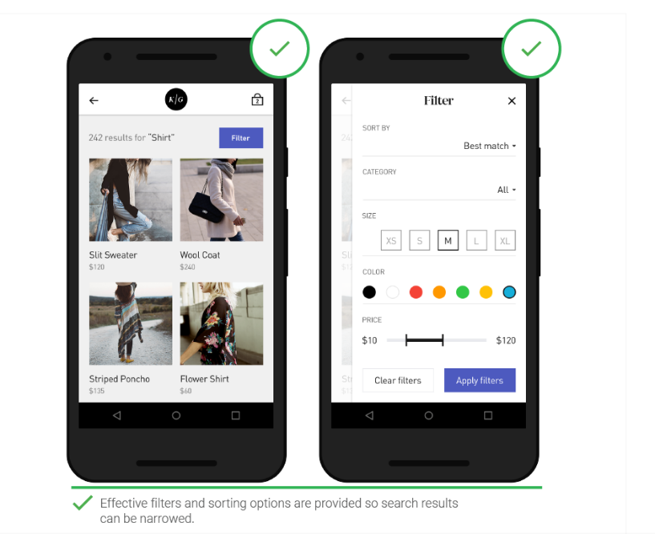
Provide filter and sort options.

Slide 26
Chapter 3: Commerce and conversions

Slide 27
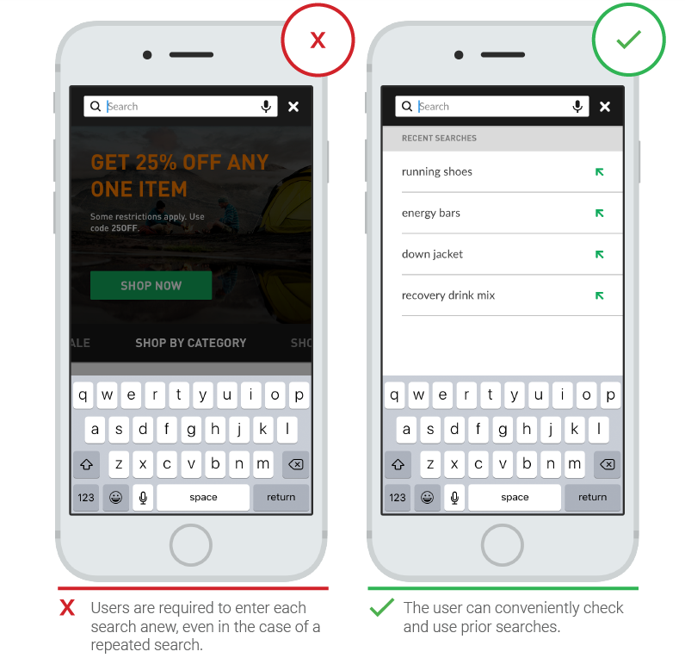
Provide previous search and purchase information.

Slide 28
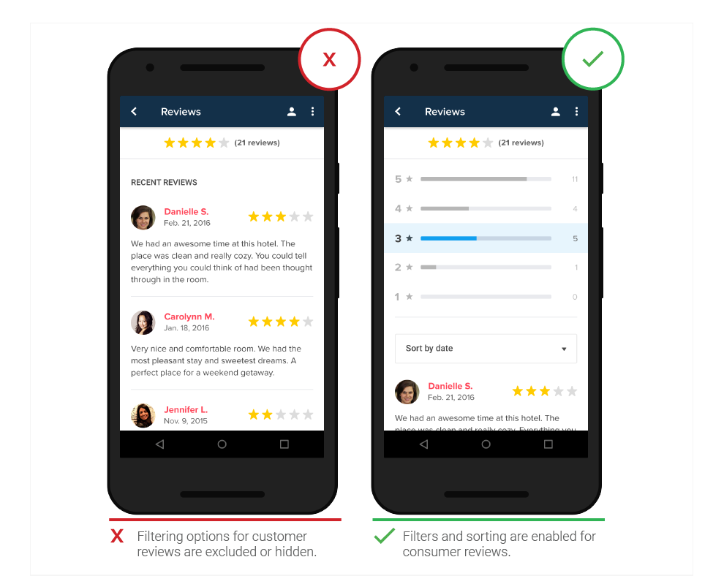
Allow user reviews to be viewed and filtered.

Slide 29
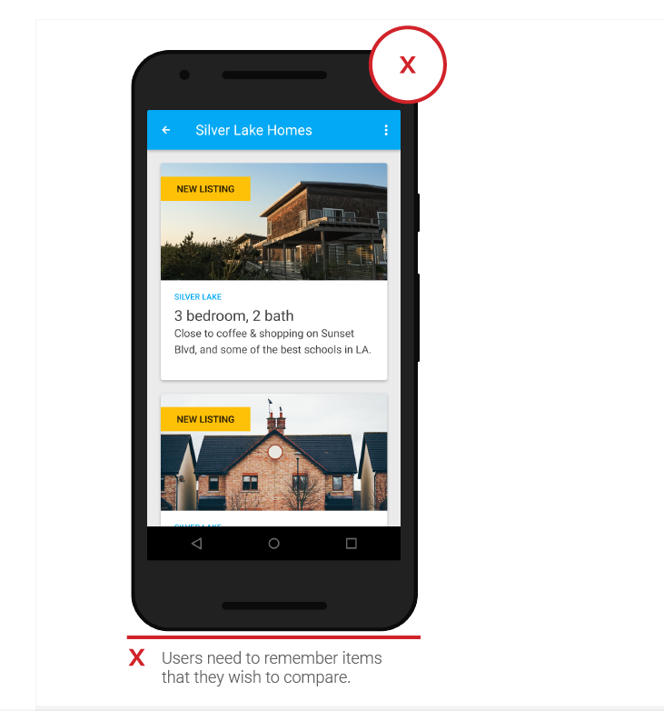
Enable comparison shopping features.

Slide 30
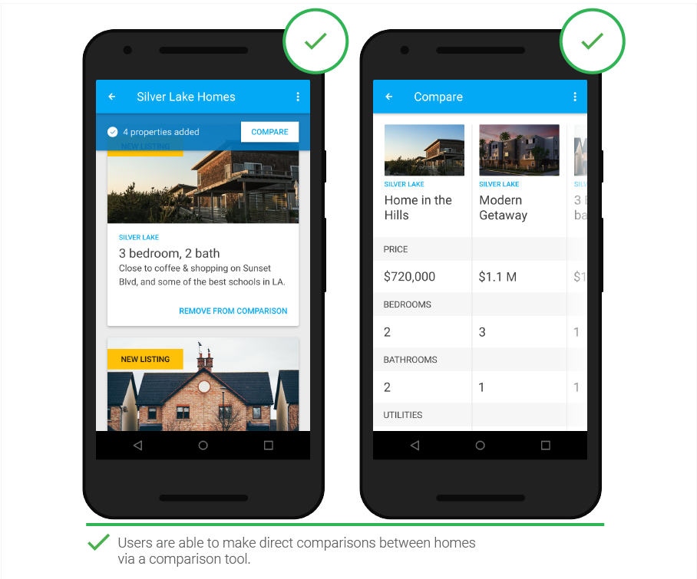

Slide 31
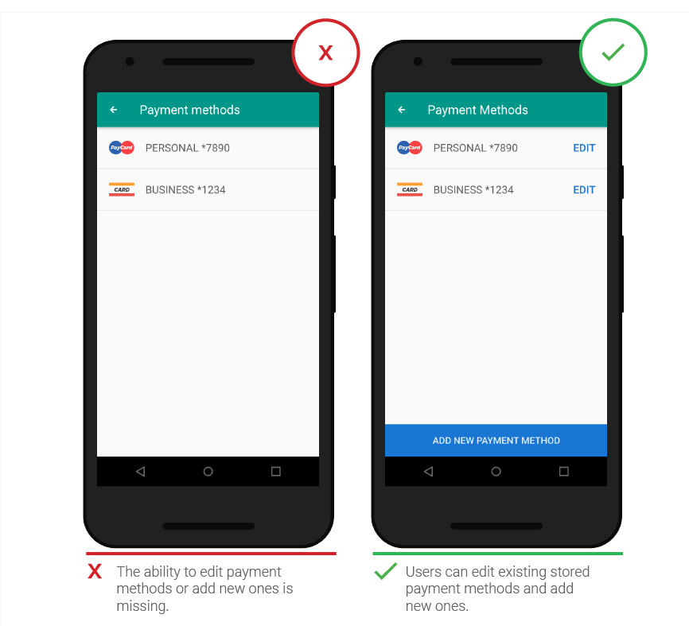
Provide multiple third-party payment options.

Slide 32
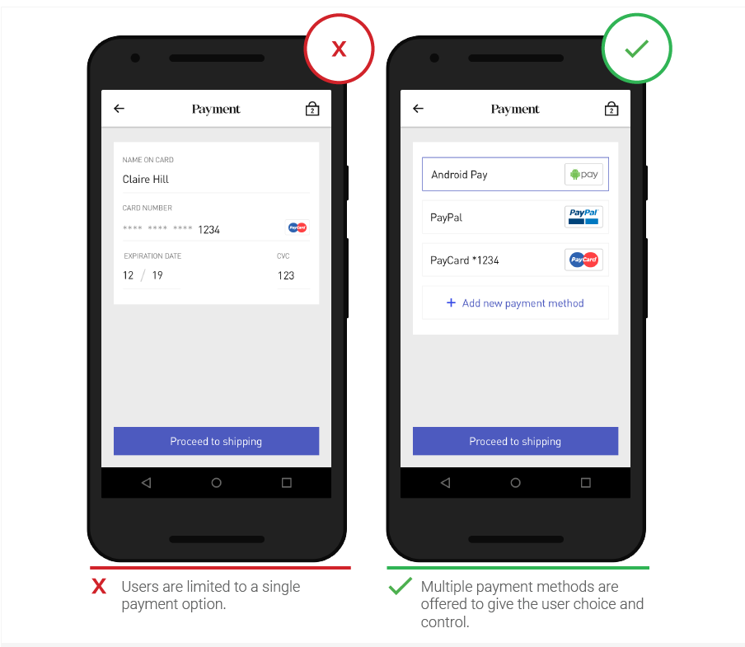
Make it easy to add and manage payment methods.

Slide 33
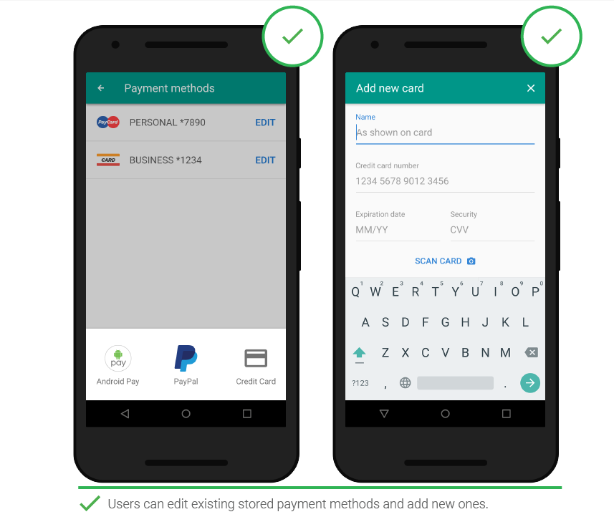

Slide 34
Chapter 4 : Registration

Slide 35
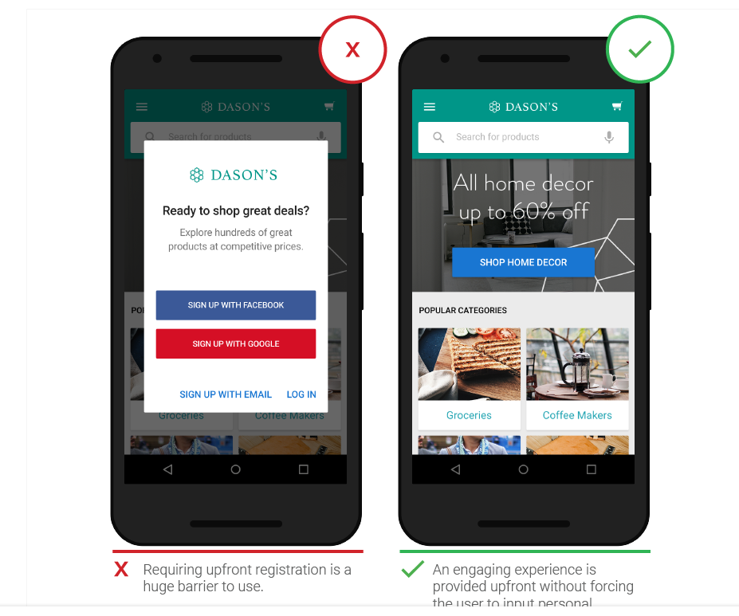
Provide clear utility before asking users to register.

Slide 36
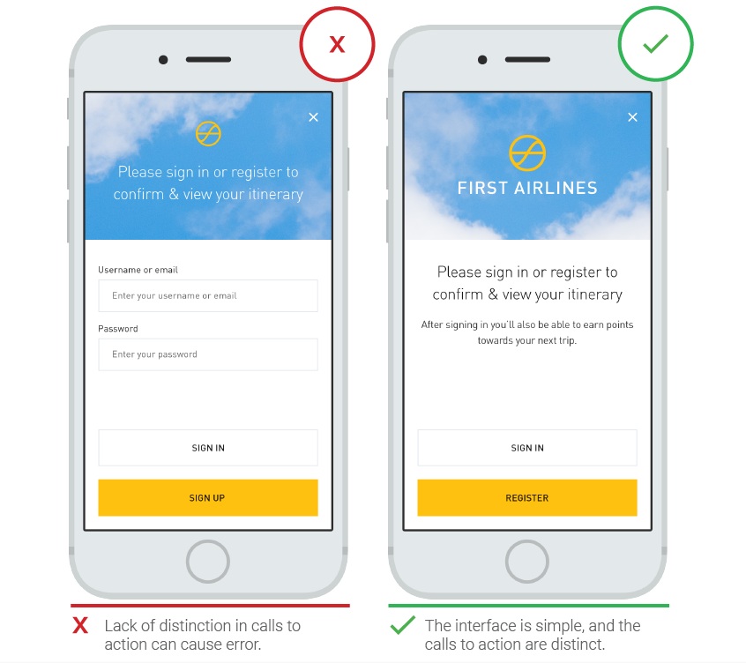
Differentiate "sign in" from "sign up."

Slide 37
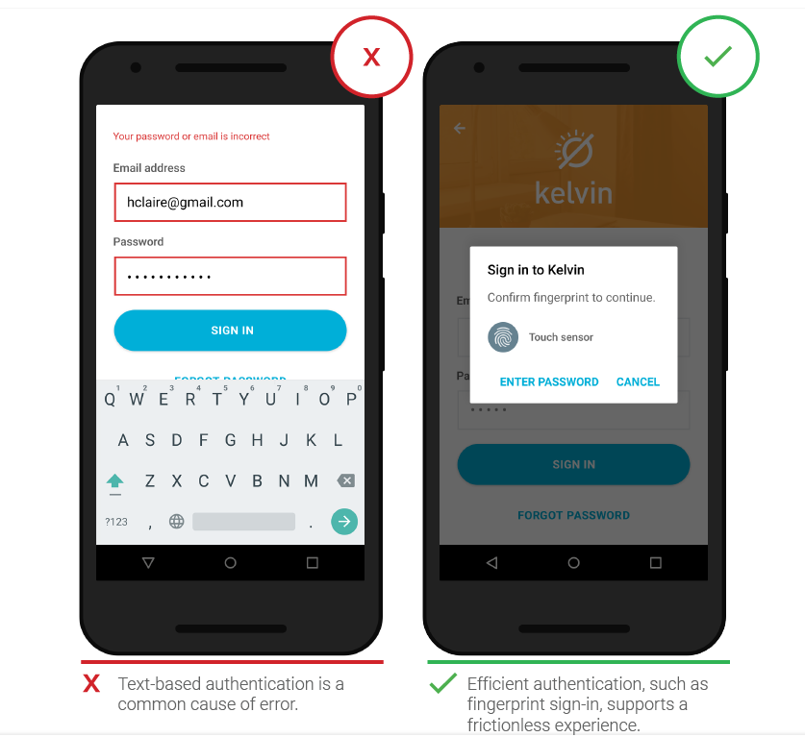
Make password authentication a frictionless experience.

Slide 38
Chapter 5 : Form Entry

Slide 39
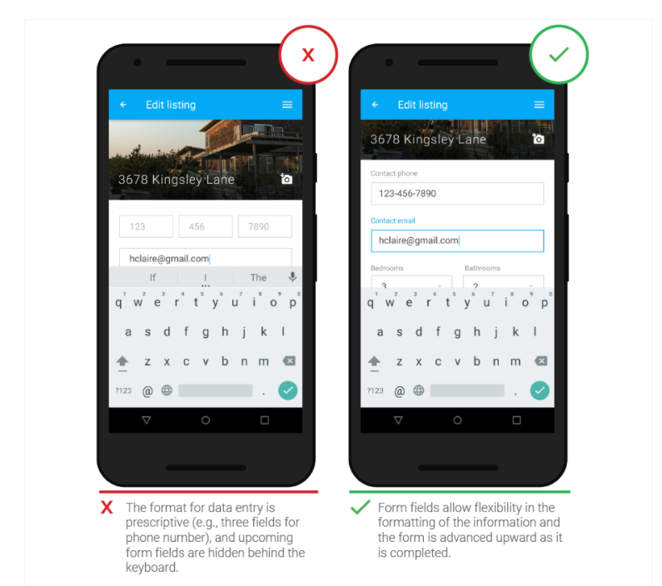
Build user-friendly forms.

Slide 40
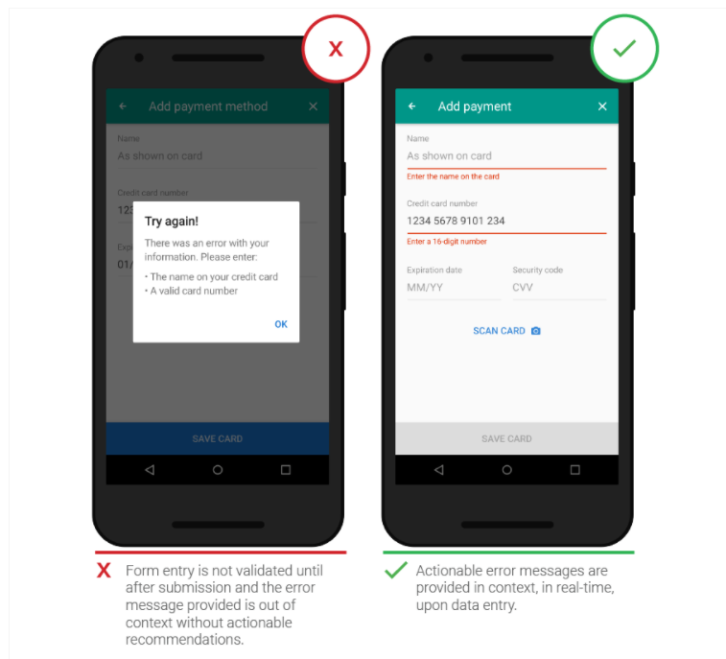
Communicate form errors in real time.

Slide 41
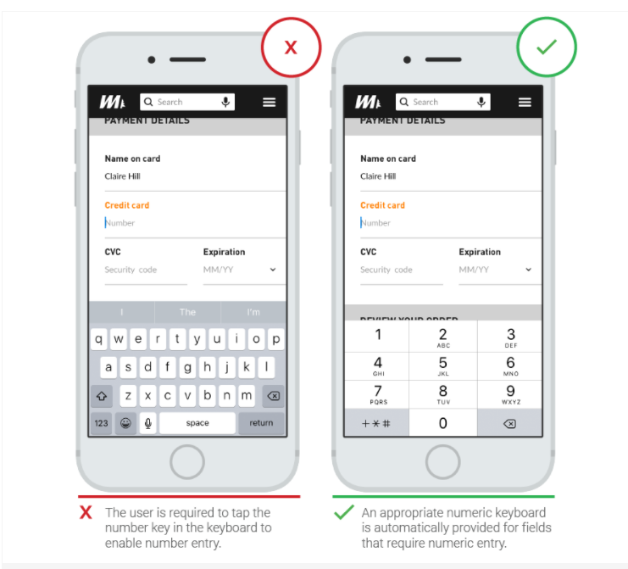
Match the keyboard with the required text inputs.

Slide 42
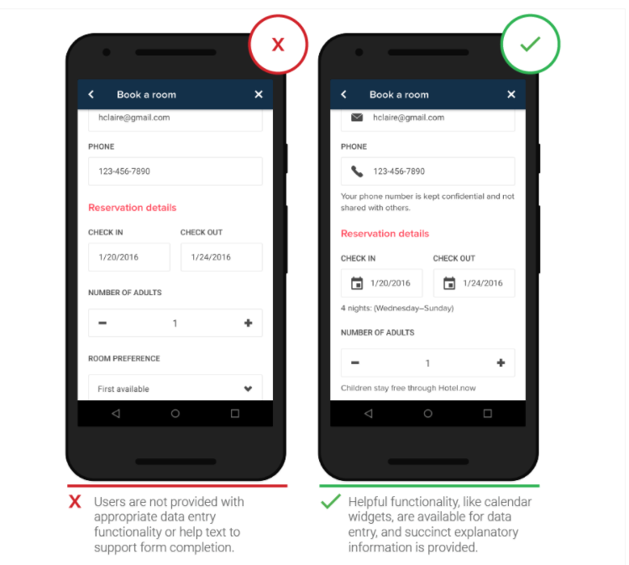
20. Provide helpful information in context in forms.

Slide 43
Chapter 6: Usability and Comprehension

Slide 44
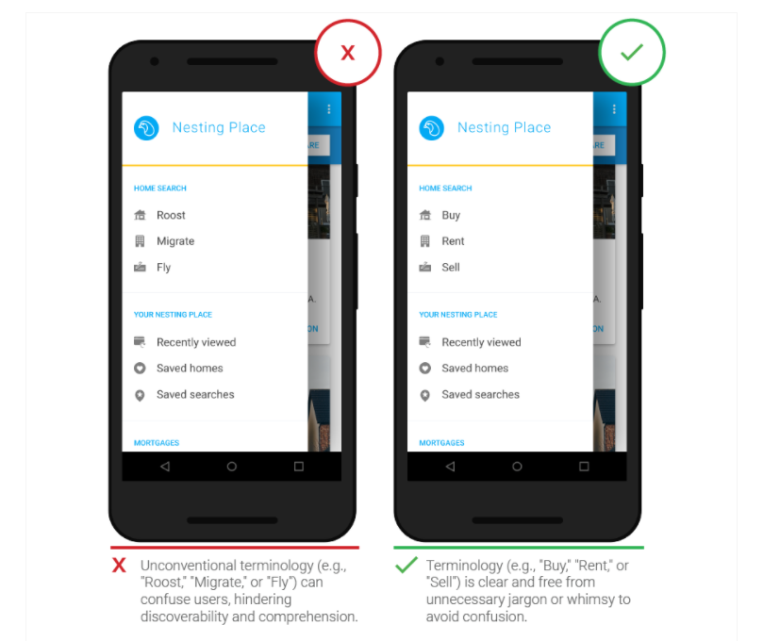
Speak the same language as your users.

Slide 45
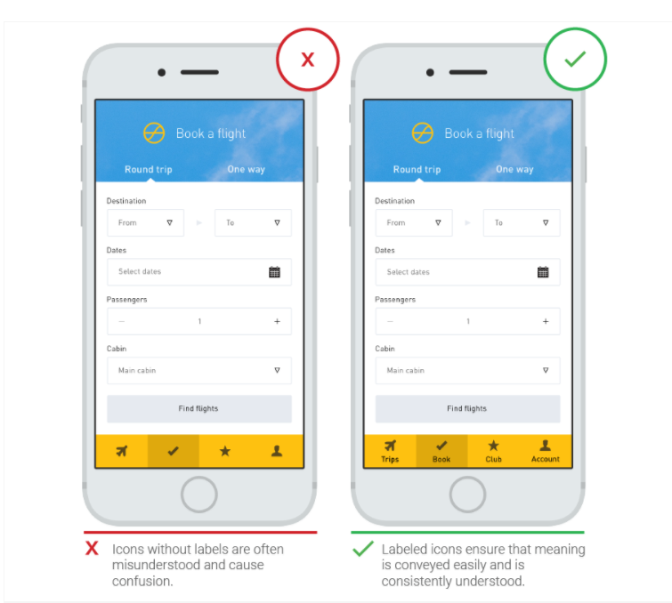
Provide text labels and visual keys to clarify visual information.

Slide 46
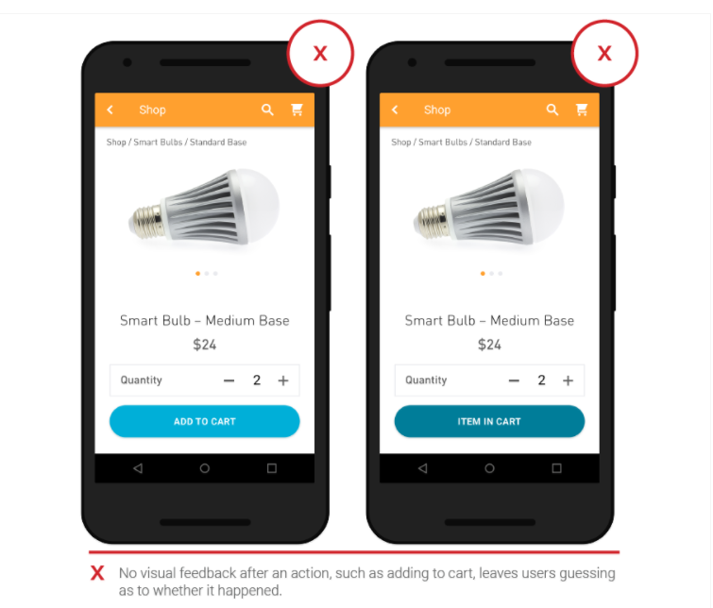
Be responsive with visual feedback after significant actions.

Slide 47
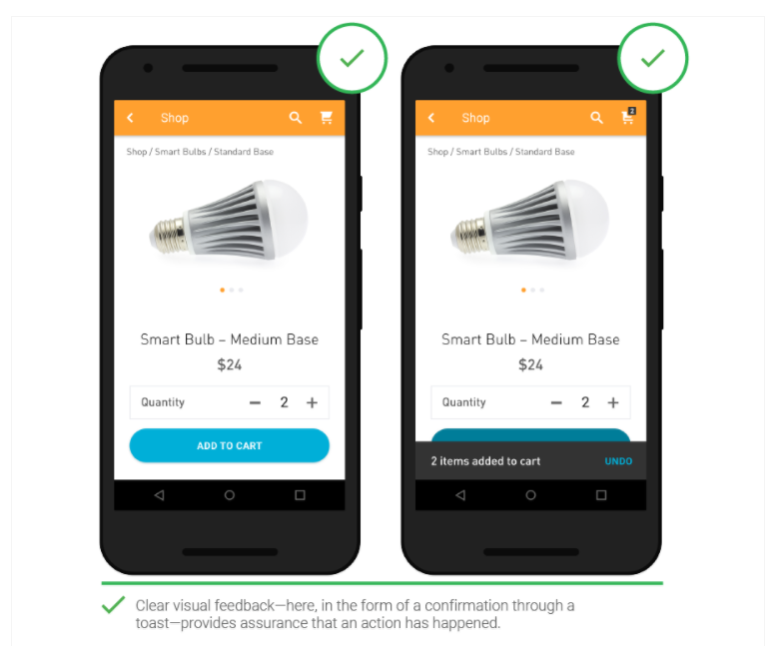

Slide 48
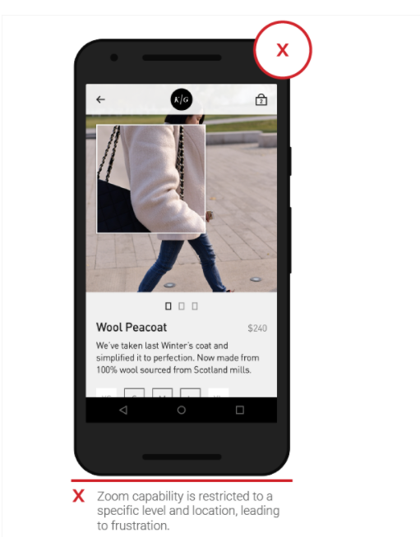
Let the user control the level of zoom.

Slide 49
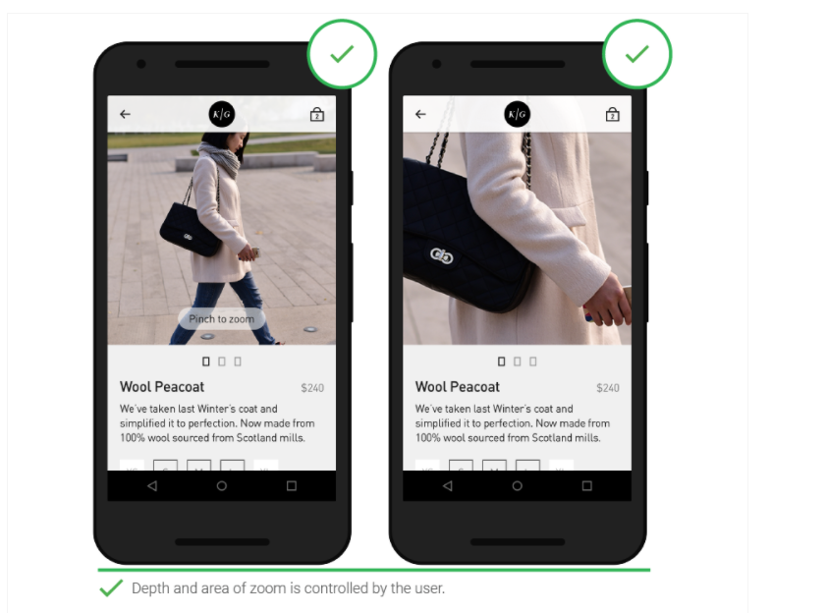

Slide 50
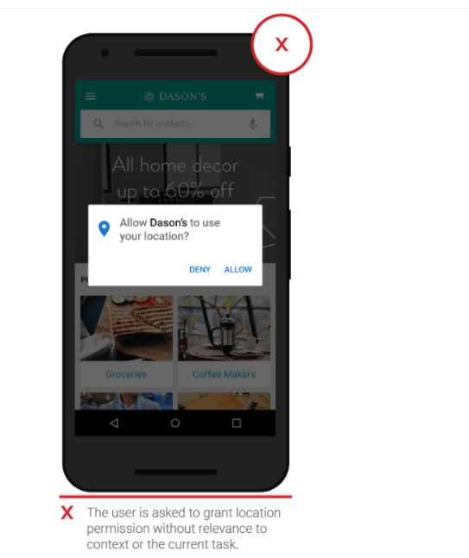
Ask for permissions in-context.

Slide 51
